Slide 1
Overview of BNB Smart Chain
Key Technical and Structural Facts
Yauheni Chekan
S = 9 + 4 + 86 = 99
R = 99 % 16 + 1 = 4

Slide 2
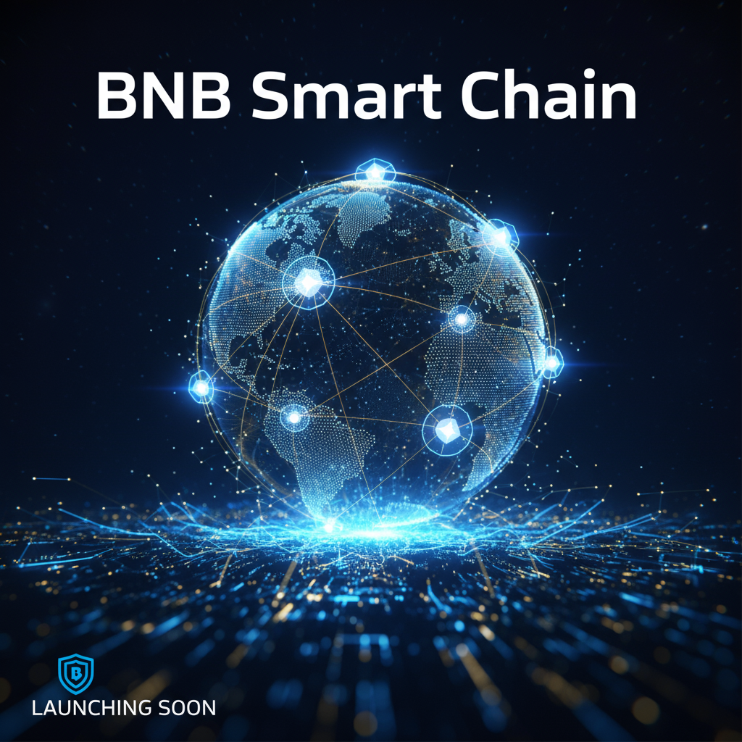

BSC Network Identity
Name: Binance Smart Chain (BSC)
Mainnet Launch Year: Sept 2020

Slide 3

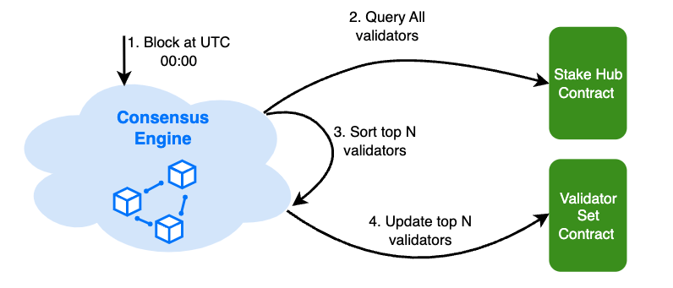
Consensus Protocol
Proof of Staked Authority
=
Delegated Proof of Stake
+
Proof of Authority
Allows BSC to achieve fast block times and low fees by limiting the number of validators while maintaining decentralization through staking.

Slide 4
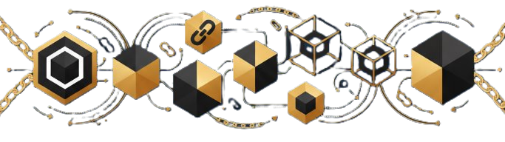
On-Chain Ledger Structure
Topology: Chain of Blocks
Each block contains a cryptographic hash of the previous block
Follows traditional blockchain architecture

Slide 5
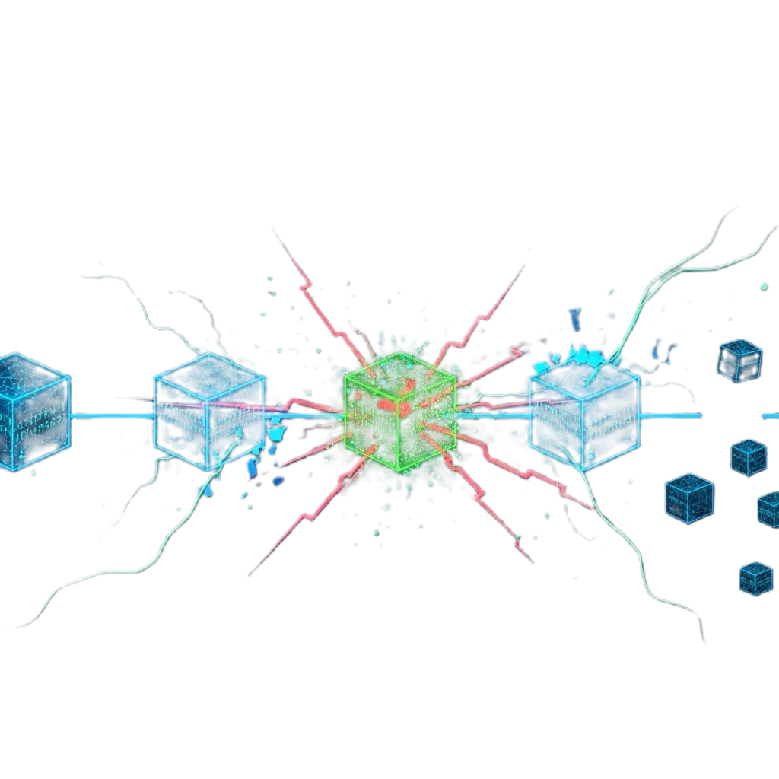
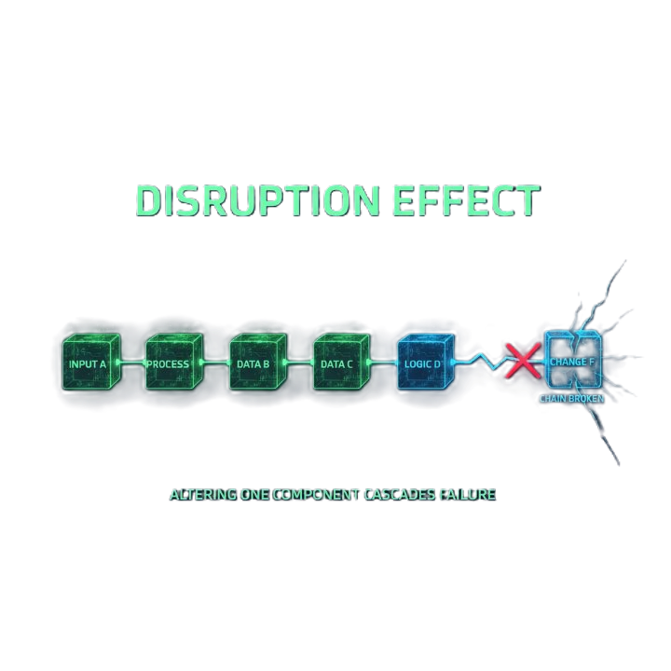
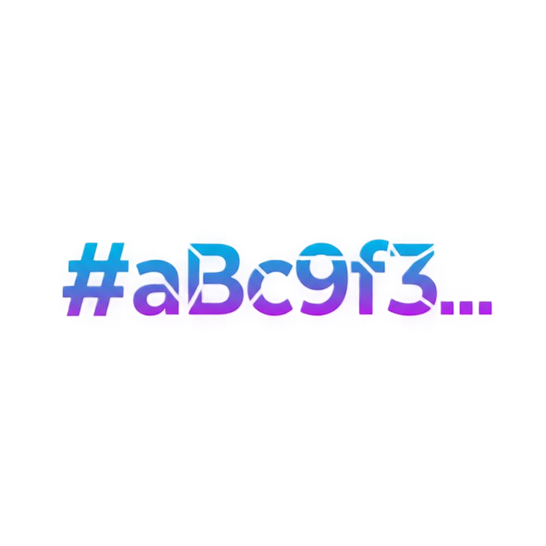
Immutability & Hashing
Hash Algorithm: Keccak-256 (SHA-3 family)
Ensures data integrity and security
Immutability achieved through cryptographic linking of blocks

Slide 6
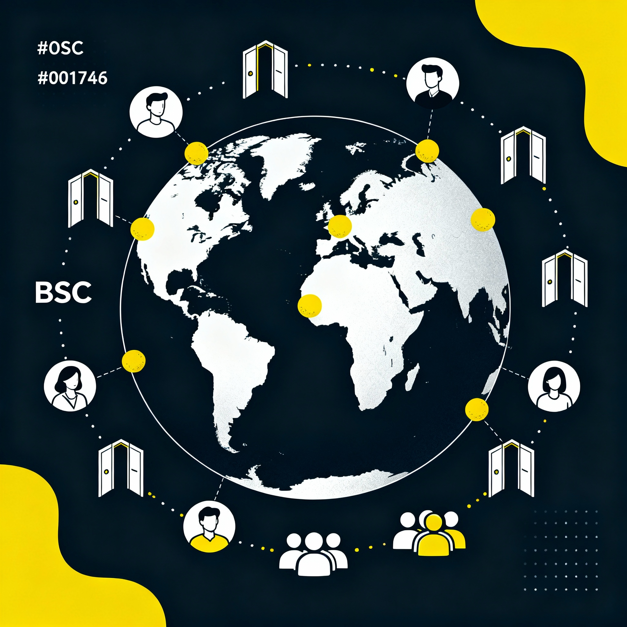
Network Accessibility
Model: Public Blockchain
Anyone can join, read data, and interact with smart contracts
BSC is open to all users globally, promoting transparency and inclusivity in decentralized finance

Slide 7
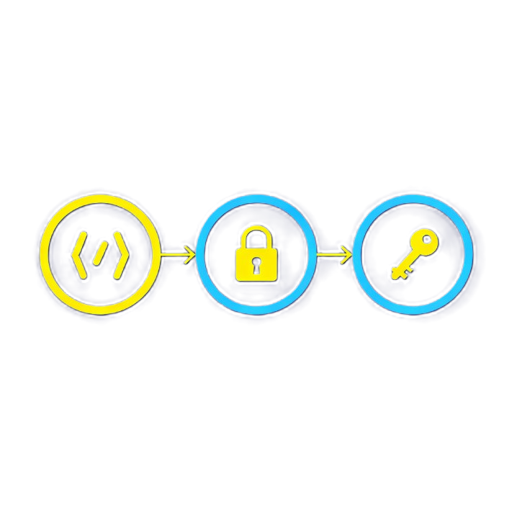
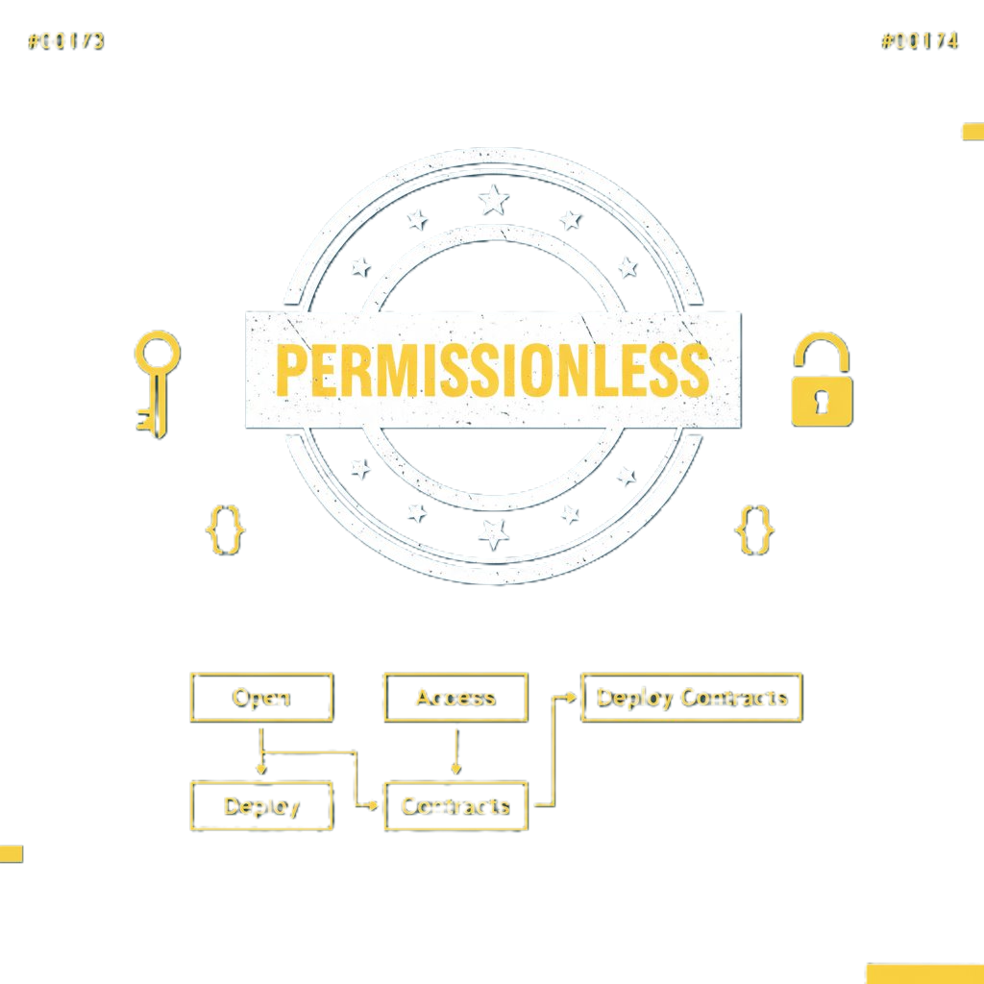
Permissionless Architecture
Type: Permissionless
No central authority required to validate transactions
Developers can deploy smart contracts freely

Slide 8
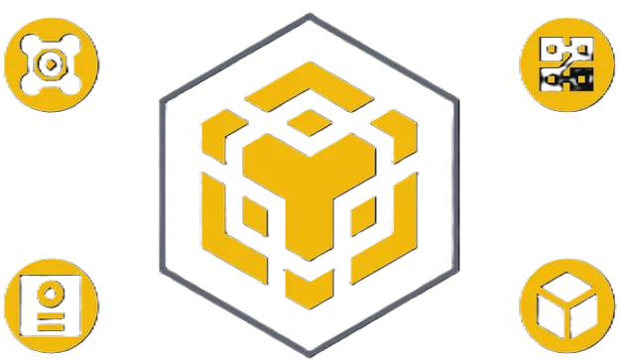

BSC Technical Summary
Network Name | Binance Smart Chain
Launch Year | September 2020
Consensus | Proof of Staked Authority (PoSA)
Ledger Topology | Chain of Blocks
Hash Algorithm | Keccak - 256
Join Model | Public
Permission Model | Permissionless
Home Page | www.bnbchain.org

